Slide 1


Flashlight-based Emergency Evacuation System
Team : HotSource
Task Representative Student : Seon jae Kim
Team Member : Kim Seon Jae, Kim Hyeong Do, Park Moo chang, Jeong Seung Ju, Choi Min Seok

Slide 2
Table of Contents
Introduce Project
Design & Function
Expectation Effectiveness
Demonstrate Operation
Complementary Points

Slide 3
Introduce Project

Slide 4

Introduce Project
selection process
What is Inconvenience and Danger in our Life?
=>
Emergency Flashlight
Where is User’s current Location?
How many People inside There?

Slide 5

Introduce Project
Task goals
☑
Users can easily identify where they are now.
=>
☑
Rescuers can obtain additional information on the presence and location of the evacuees.
In the event of an evacuation situation, faster escape and rescue are possible.

Slide 6
Introduce Project
Team Role
Kim Seon Jae
HW Design , Test
Park Moo Chang
Kim Hyeong Do
HW Design, Web UI
Application UI , UX
Choi Min Seok
Jeong Seung Ju
HW Design, Development
Server and Back-end

Slide 7
Introduce Project
Advance Schedule and Total Cost

Slide 8
Design & Function

Slide 9


Design & Function
Product and Service
Application
Beacon Device
Emergency Flashlight Storage Box
Web Page
Emergency Flashlight

Slide 10
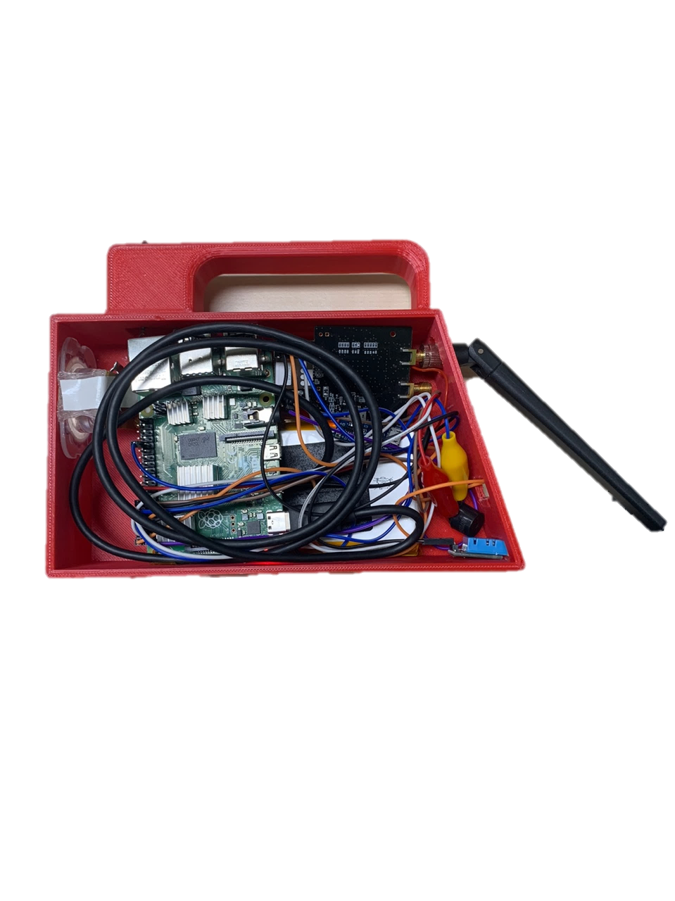
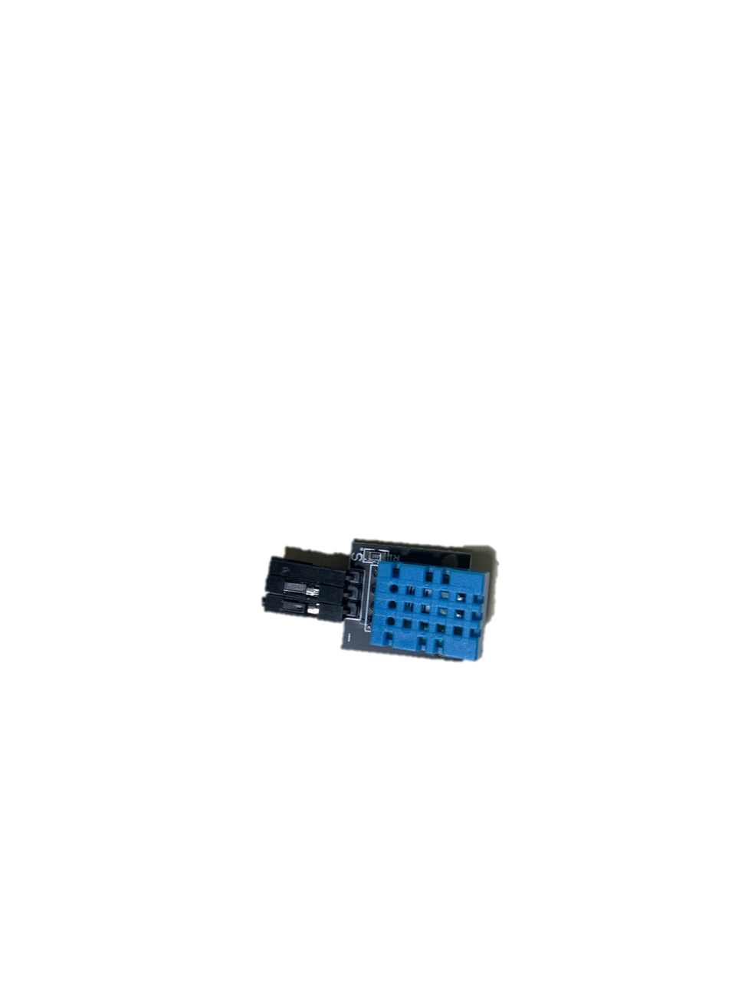
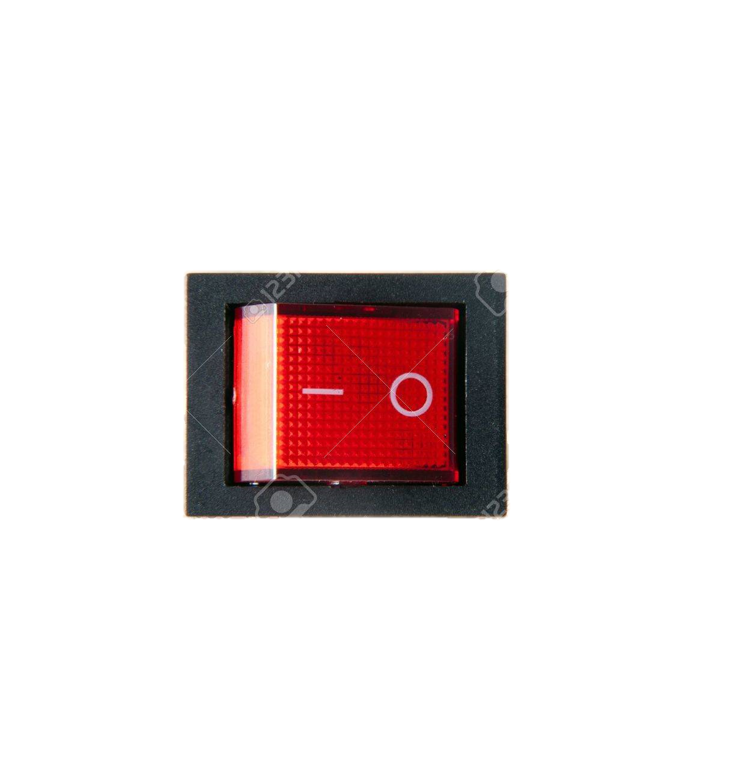

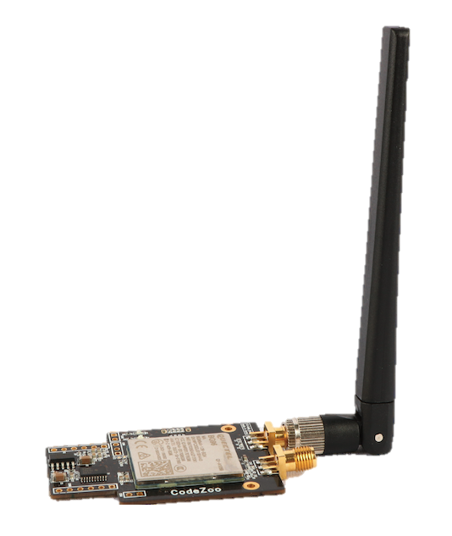
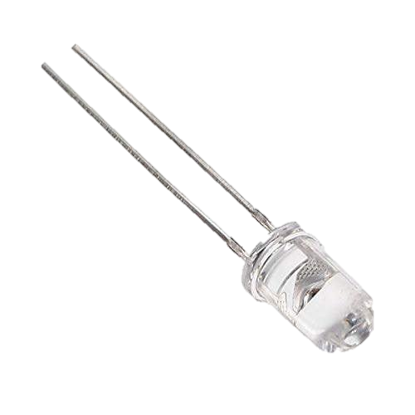
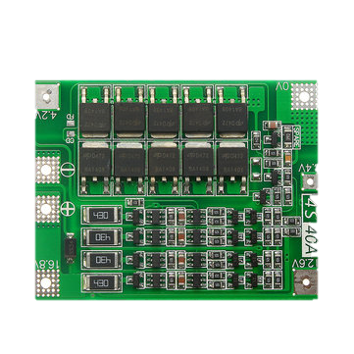
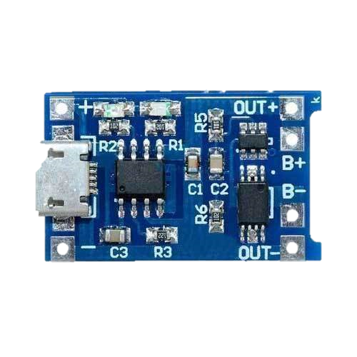

Design & Function
Flashlight
Feature Description
Receive a Location ID from the connecting Beacon
Send the Location ID to the Server
Battery can Charge with micro 5 pin cable
Turn On and Off the Raspberry pi with Micro Switch
Piezo buzzer sound when Receive the ID
Check Temperature and Humidity
Function Module
Raspberry Pi 4B LTE Module Antenna Switch Module White Led
18650 Battery 4s BMS Charge Module Temperature_Humidity Sensor

Slide 11
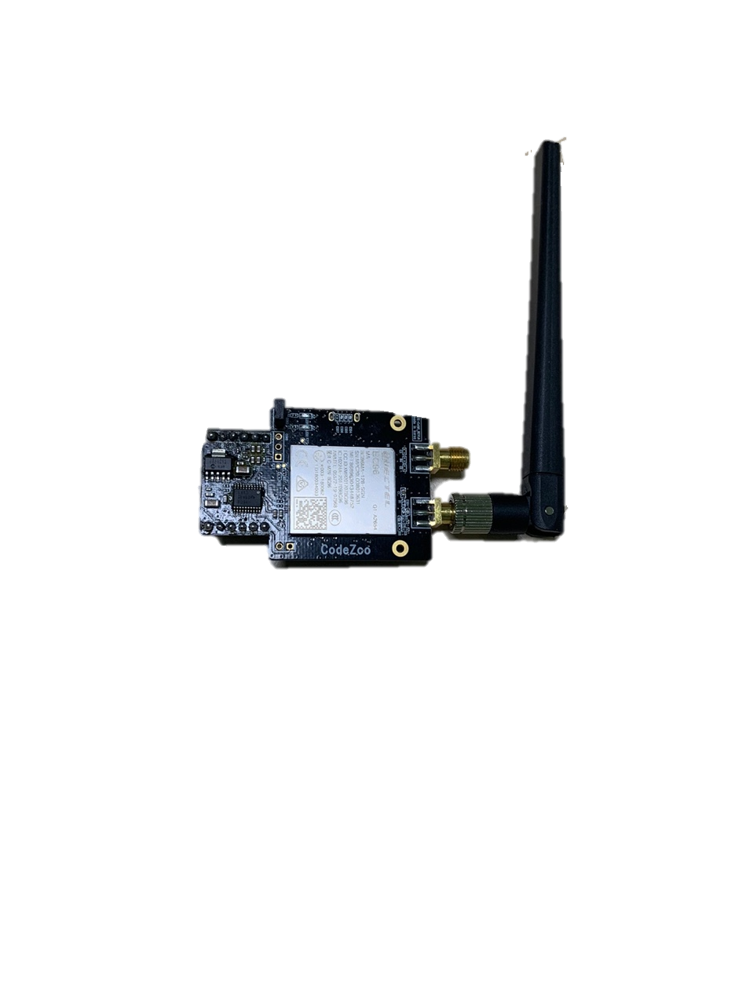
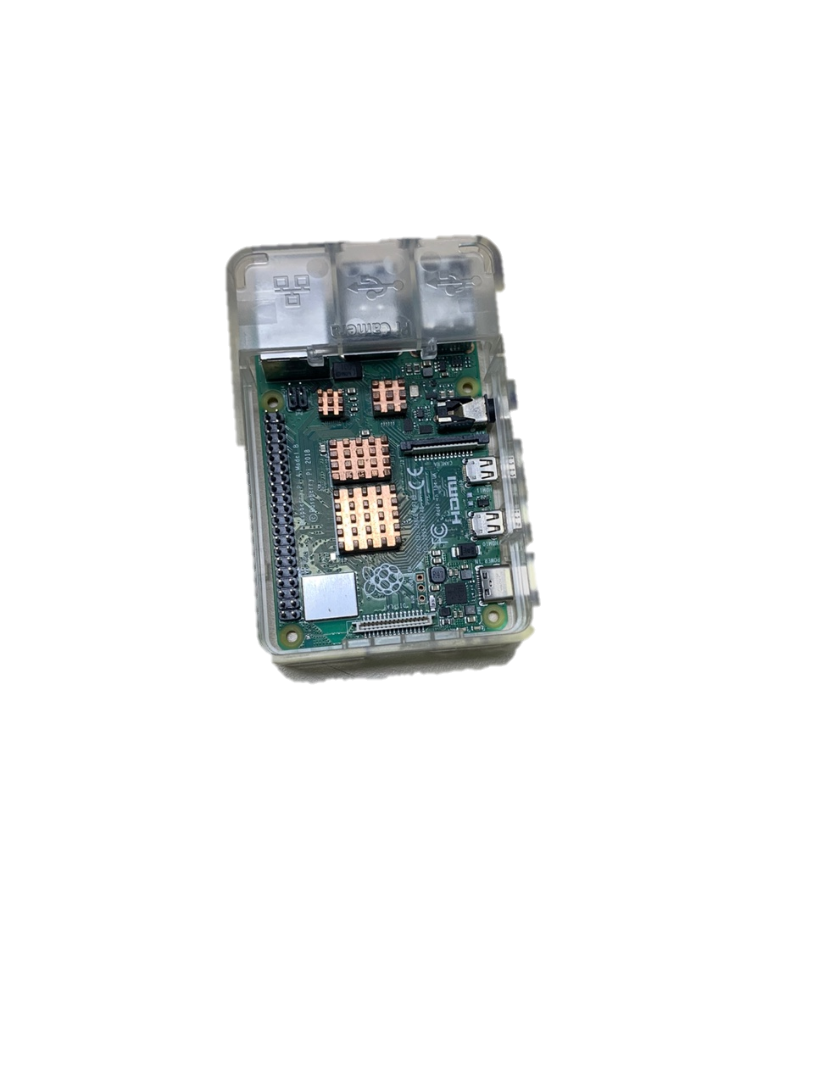
Design & Function
Flashlight Process (Hardware)
Beacon
Signal
Humidity Temperature
value
DHT 11Sensor
Raspberry Pi
LTE CAT M1

Slide 12
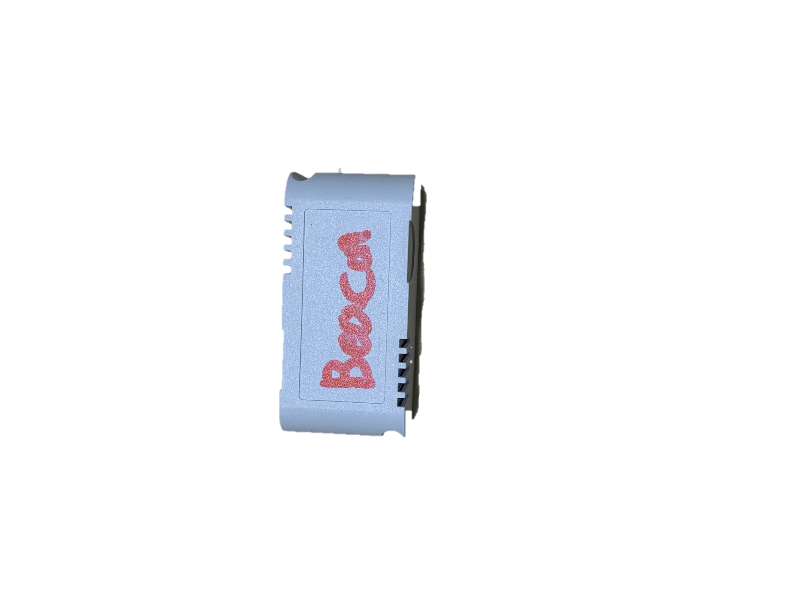



Design & Function
Flashlight Process
Bluetooth 4.0 BLE
LTE
Uuid
Uuid, Flash ID, Humid, Temper
Beacon
Flashlight
WAS

Slide 13
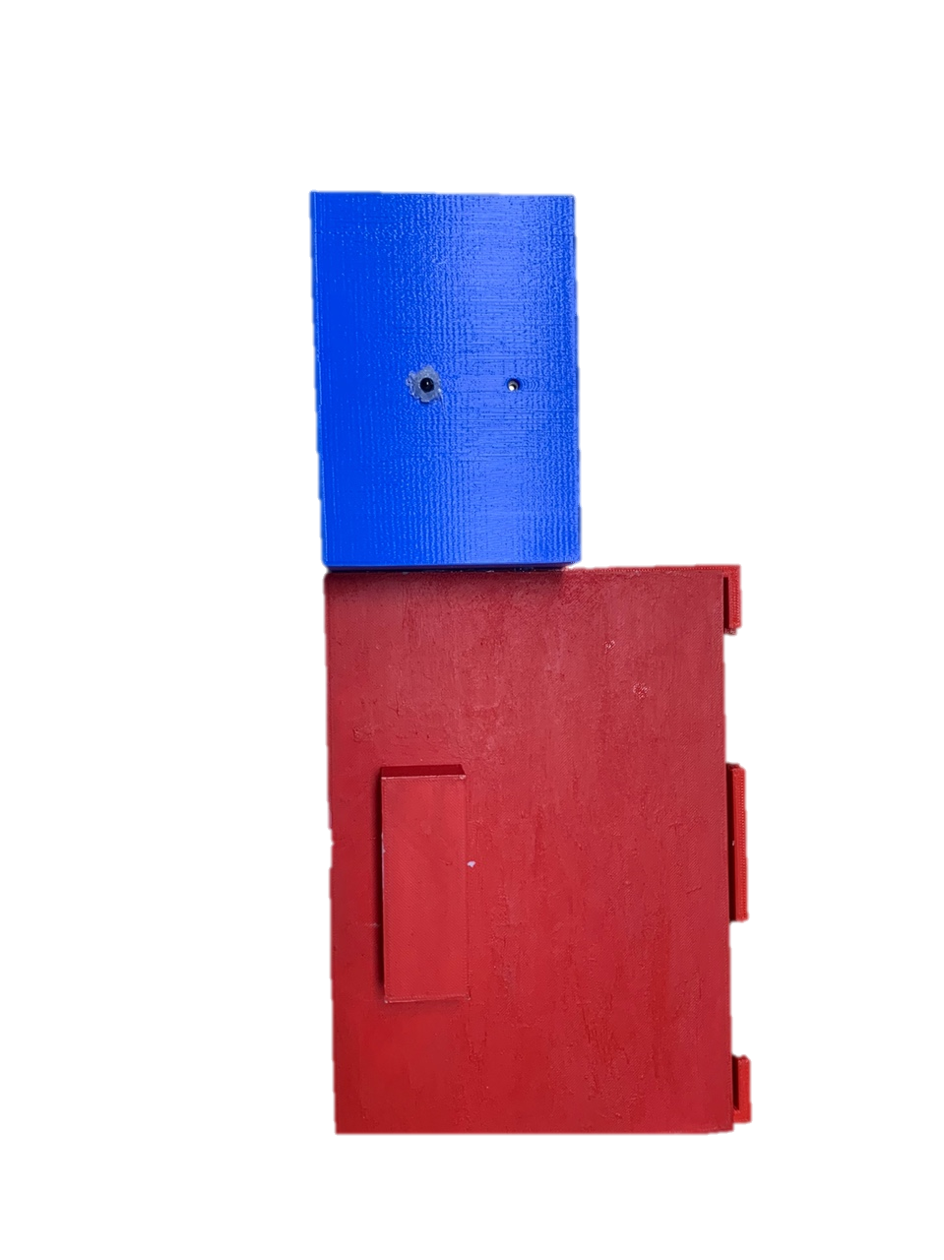

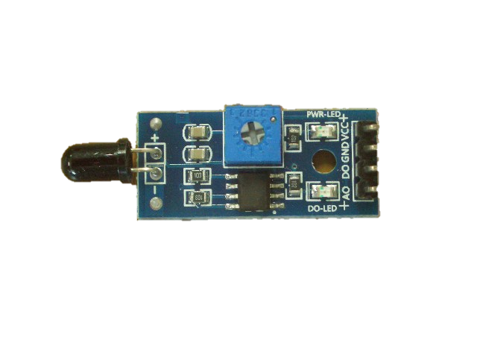

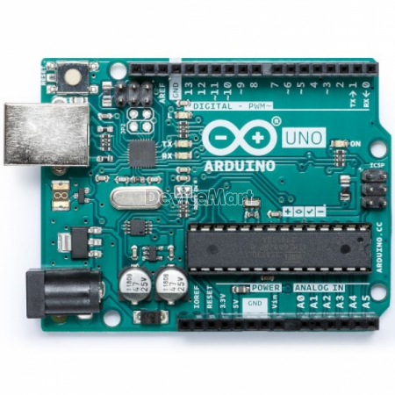
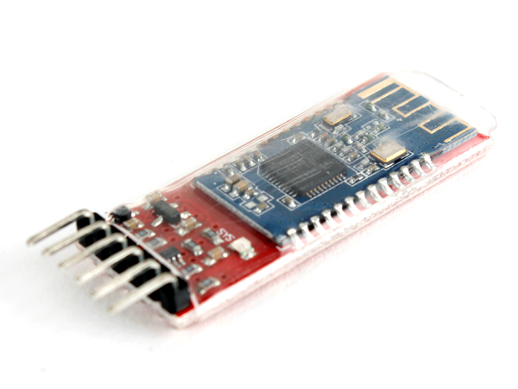

Design & Function
Storage Box and Beacon Device
Feature Description
1. Provides a Location ID for the connected device
Feature Description
Collecting Information by Flame Sensor
Makes sound in conjunction with Sensor
Function Module
Flame Sensor Piezo Buzzer Arduino Uno
Function Module
Bluetooth Module Coin Battery

Slide 14

Design & Function
Flashlight Case Process
Flame Signal
Sensor
Arduino Uno
Buzzer

Slide 15
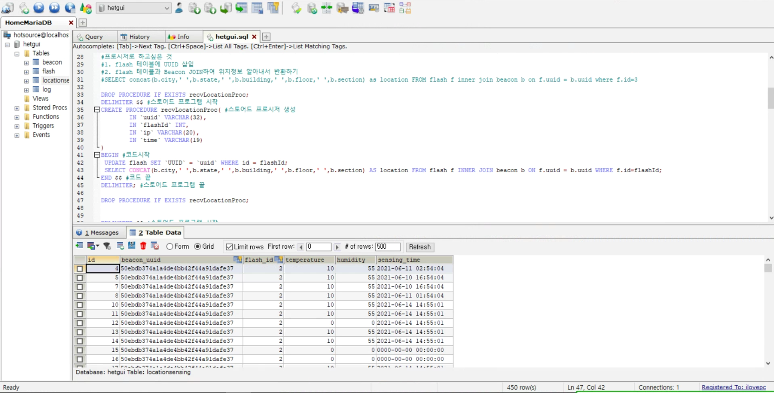

Design & Function
Web Server
Development Tools
Apache TOMCAT 9.0.45
MariaDB 10.5.9
Feature Description
Update Location data with Beacon ID when Flashlight or Mobile Phone send
Provide Images and Location data required by Web Pages and Application

Slide 16


Design & Function
Server Process (Hardware to Sever)
LTE
Data Transmission
Data List
[Raspberry Pi or SmartPhone]
DB Server

Slide 17


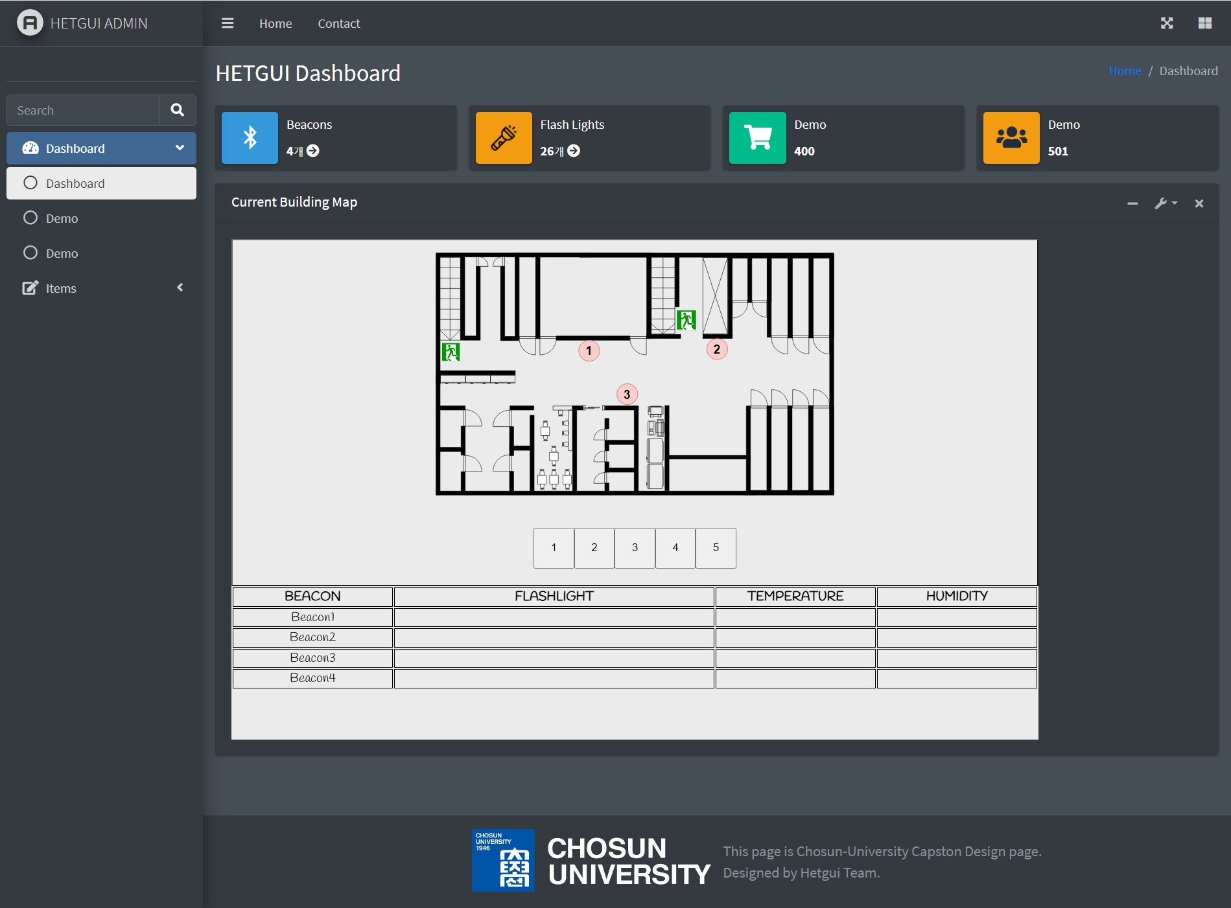
Design & Function
Web UI
Development Tools
Visual Studio CODE (HTML5, CSS3, JavaScript)
Feature Description
Display the Location of Evacuees in the Building By Pin-point on the Building Section
Display Sensor data stored on the Server

Slide 18
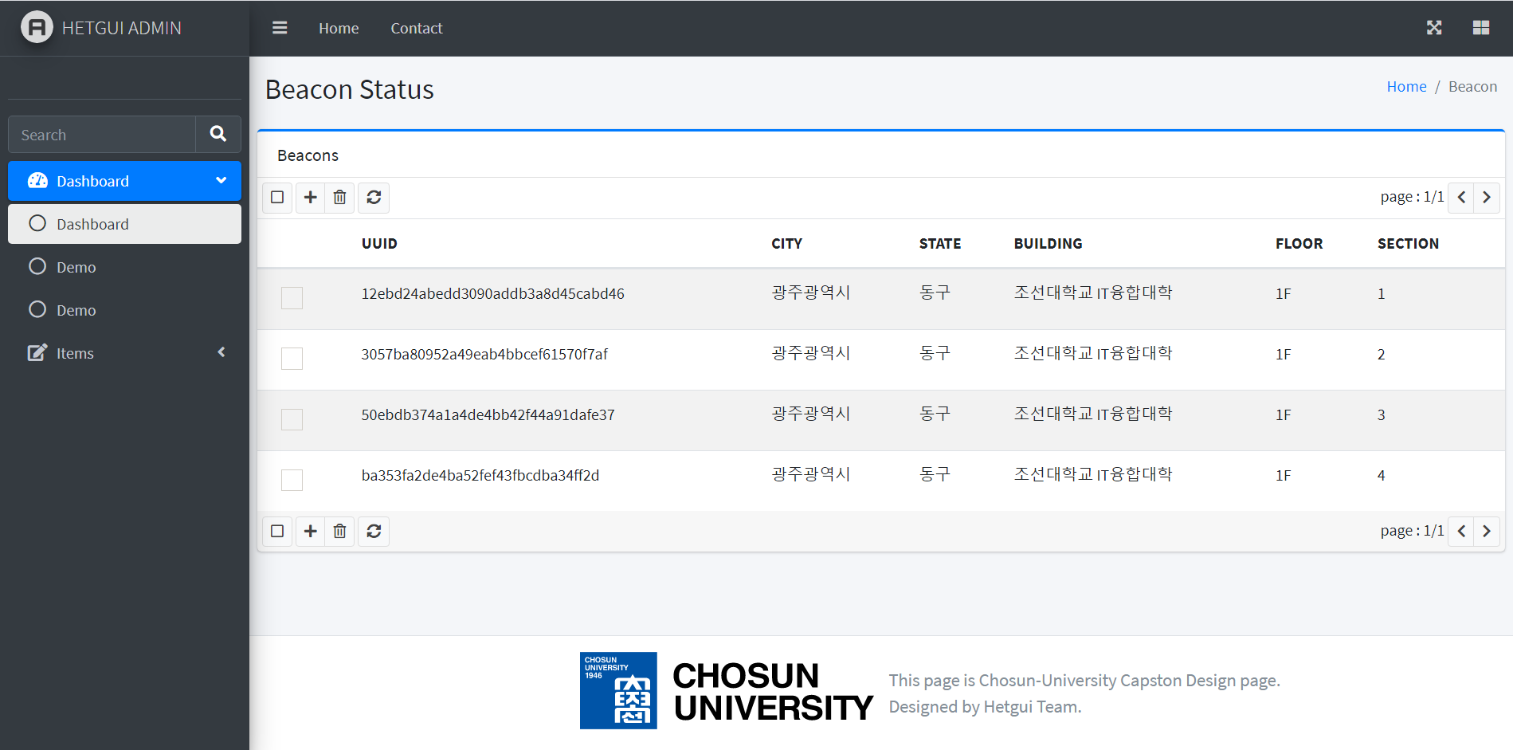
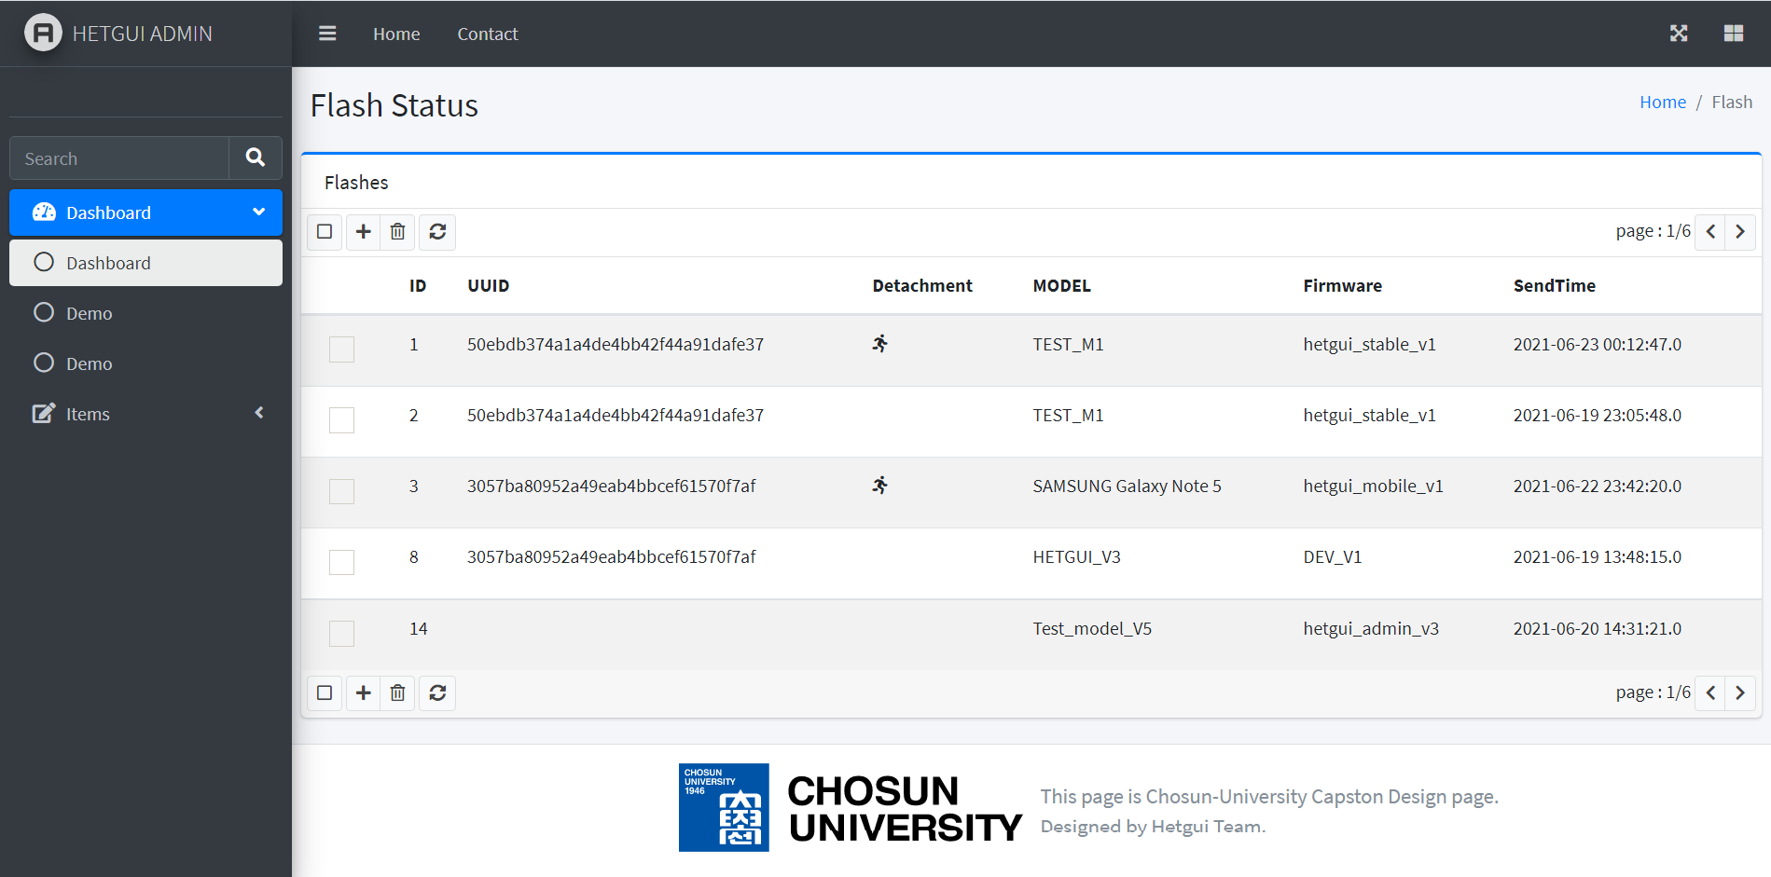
Design & Function
Admin Page Process
Administrator Page

Slide 19
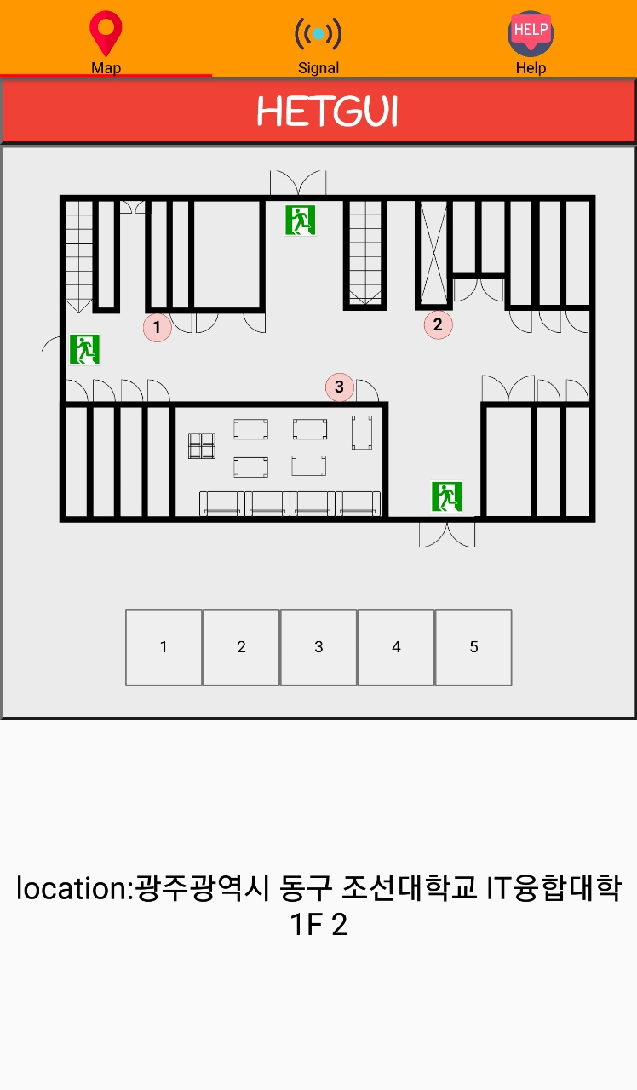
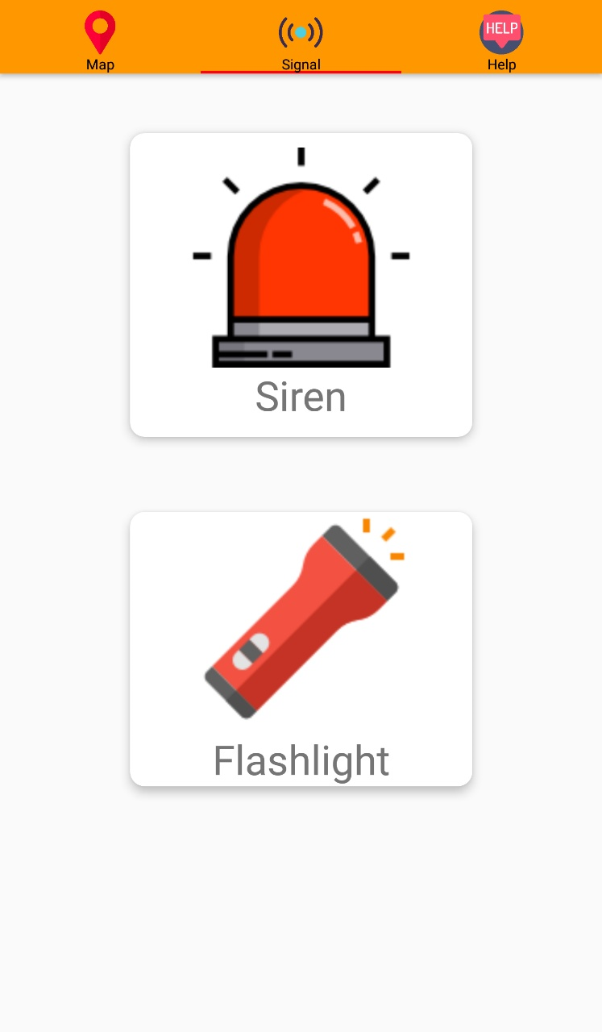
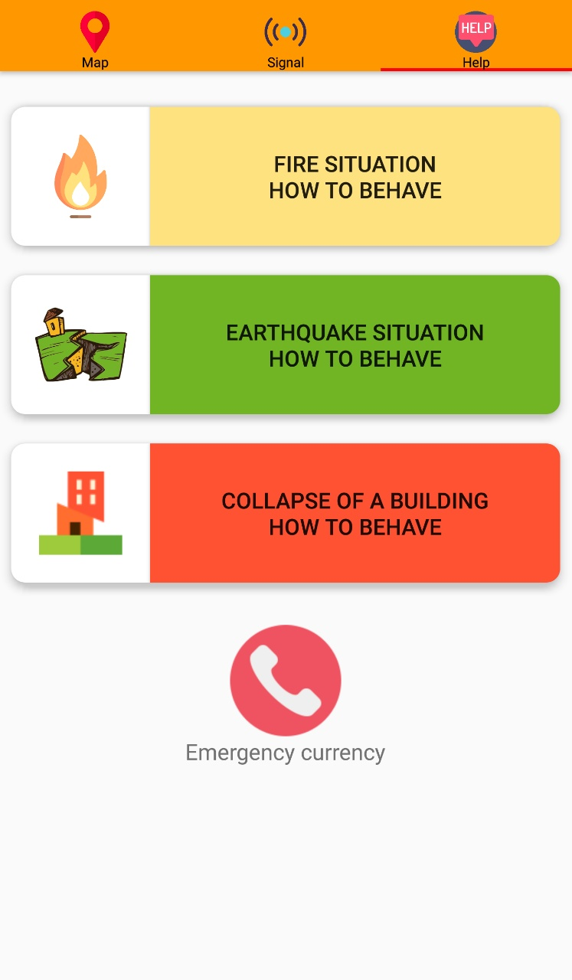

Design & Function
Application UI
Development Tools : Android Studio
Feature Description
Providing internal maps and location information of the building
Siren and flash function
Contextual evacuation instructions and emergency calls
< 1 >
< 2 >
< 3 >

Slide 20
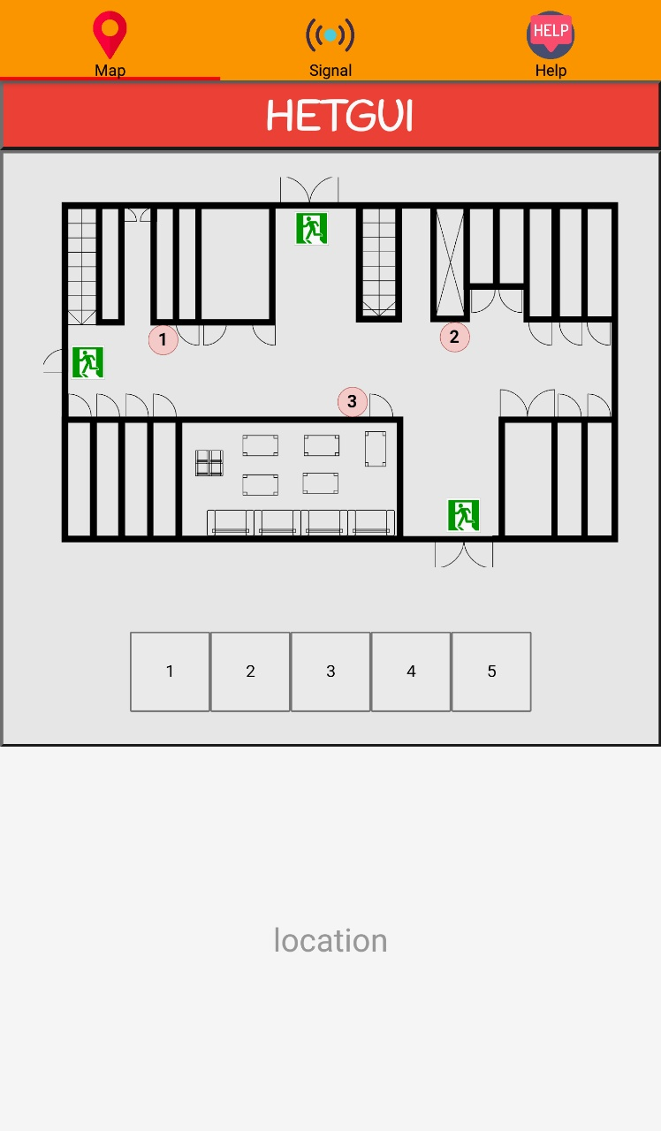
Design & Function
Smartphone Process
Bluetooth 4.0 BLE
LTE
Uuid, Flash ID
Uuid
Location Information
Beacon
Smartphone
WAS

Slide 21
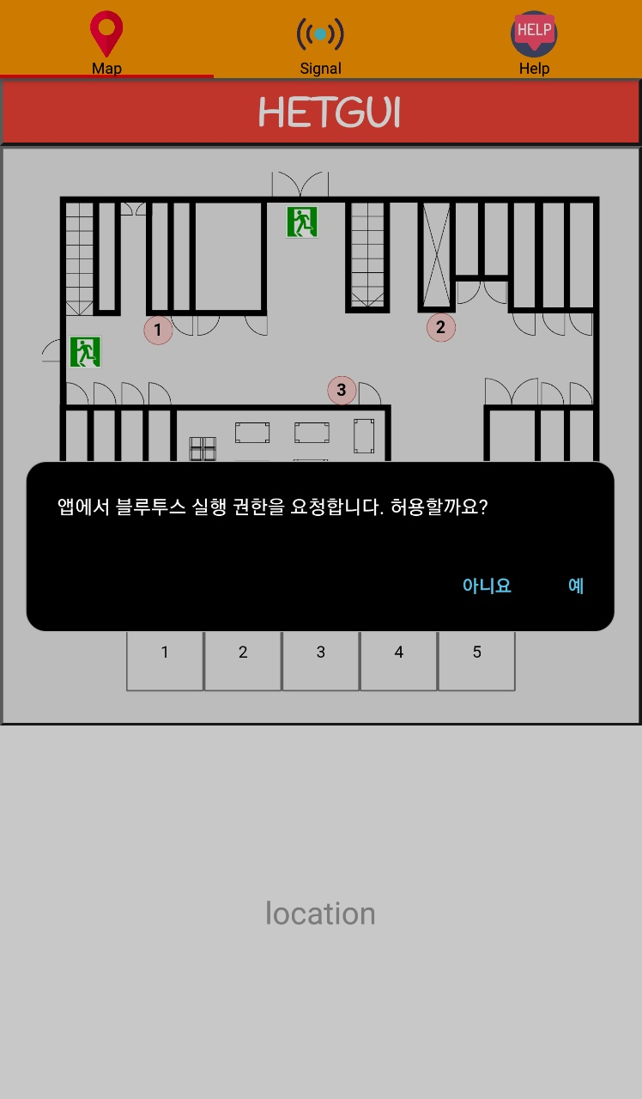

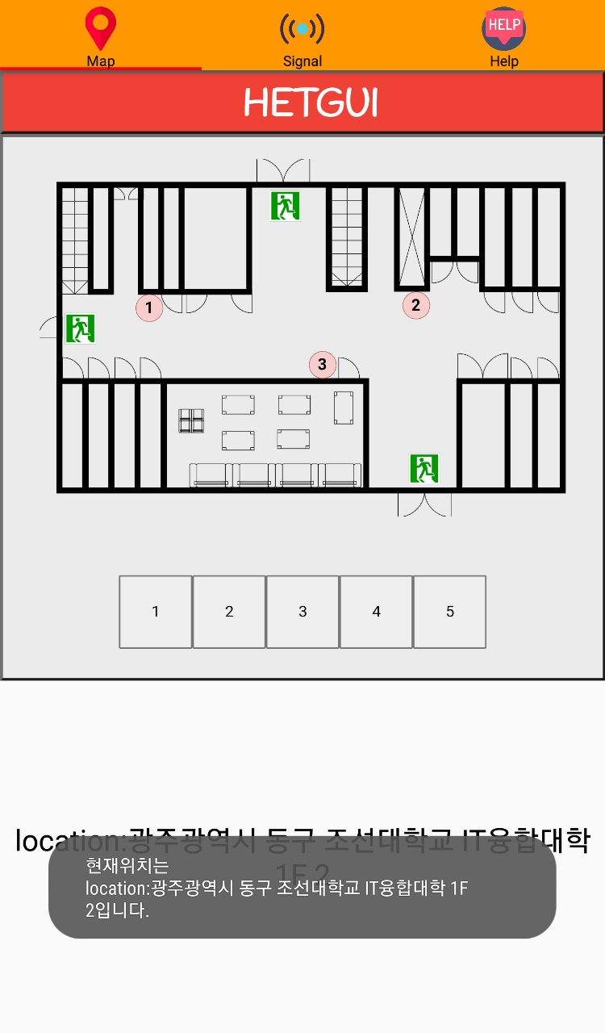
Design & Function
Application Process
Beacon
Signal
Bluetooth, Camera, location permissions
Permission setting
Main Screen
Server Communication

Slide 22
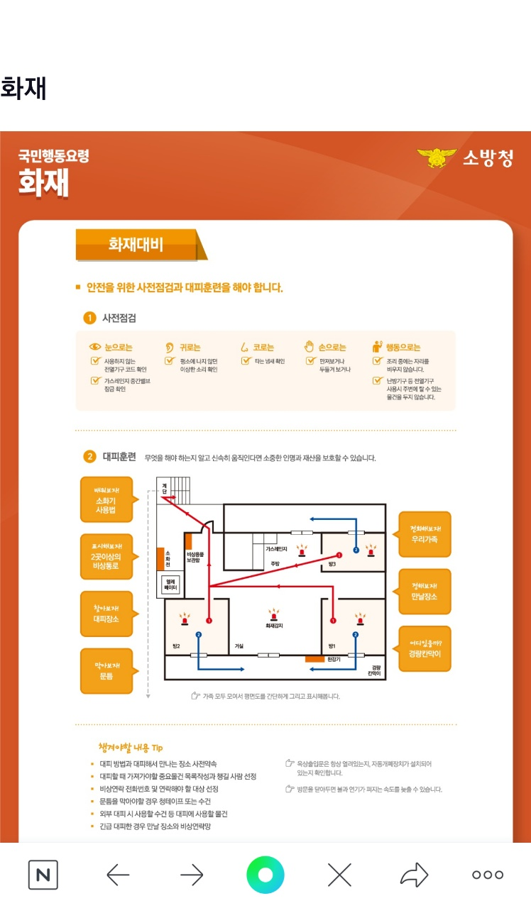
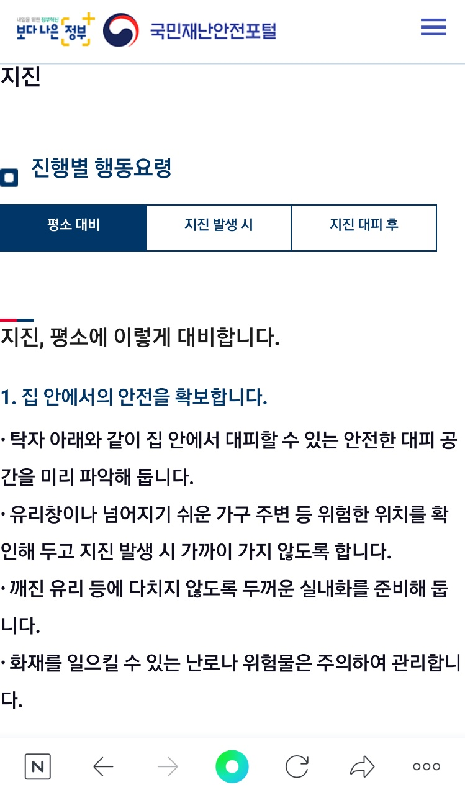

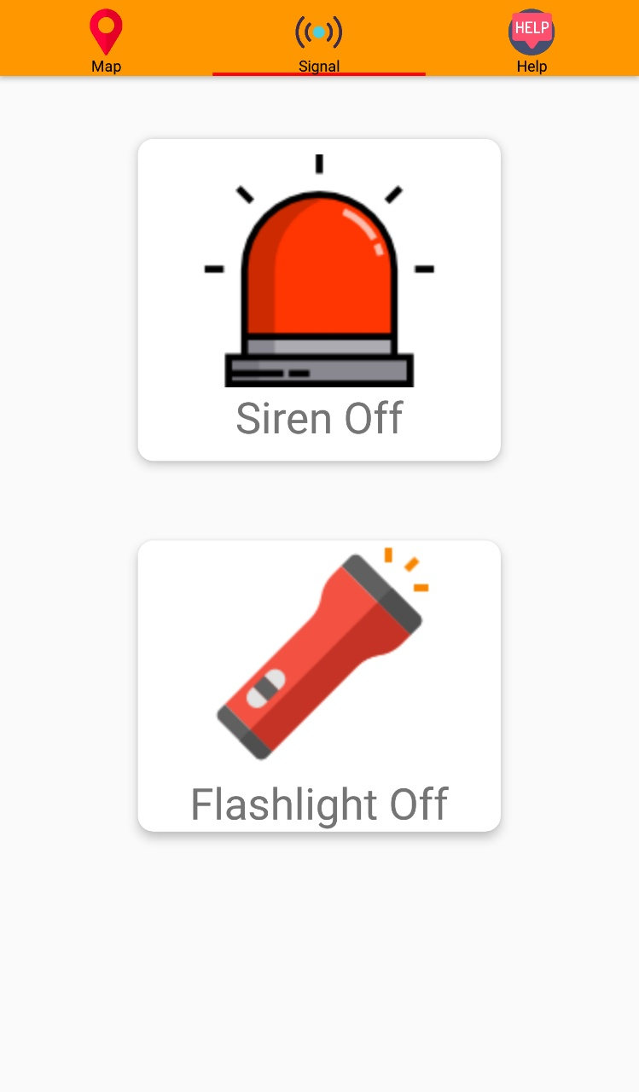

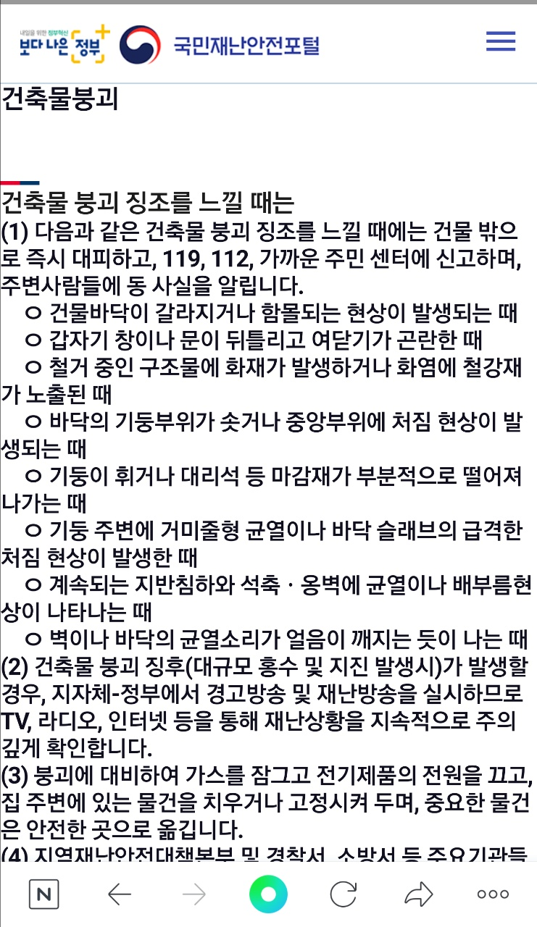
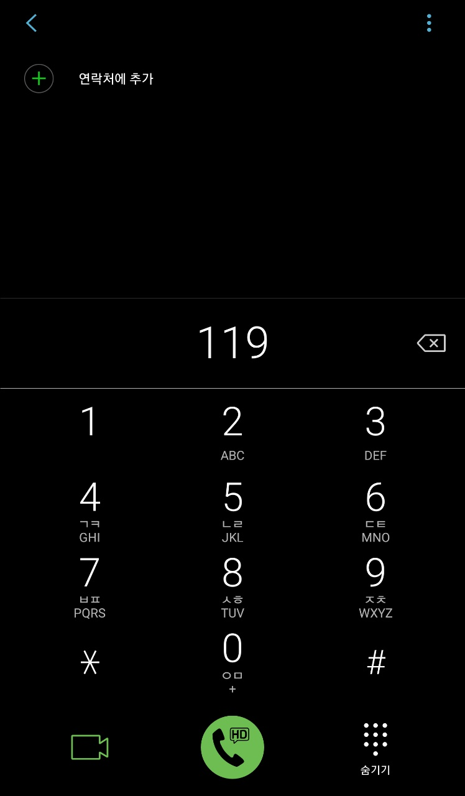
Design & Function
Application Process
Siren On Off
Evacuation link, emergency call

Slide 23

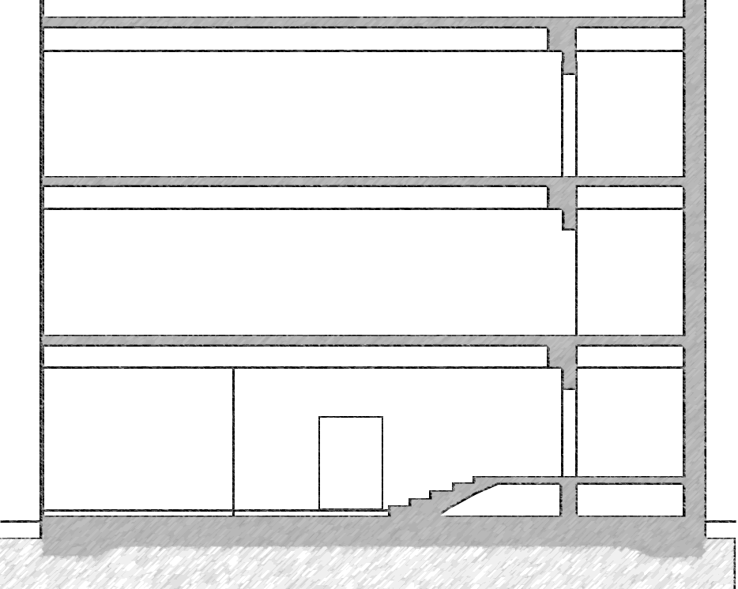

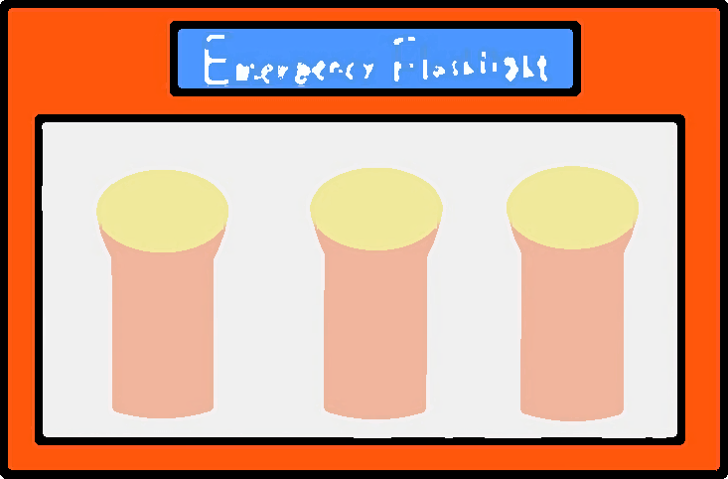







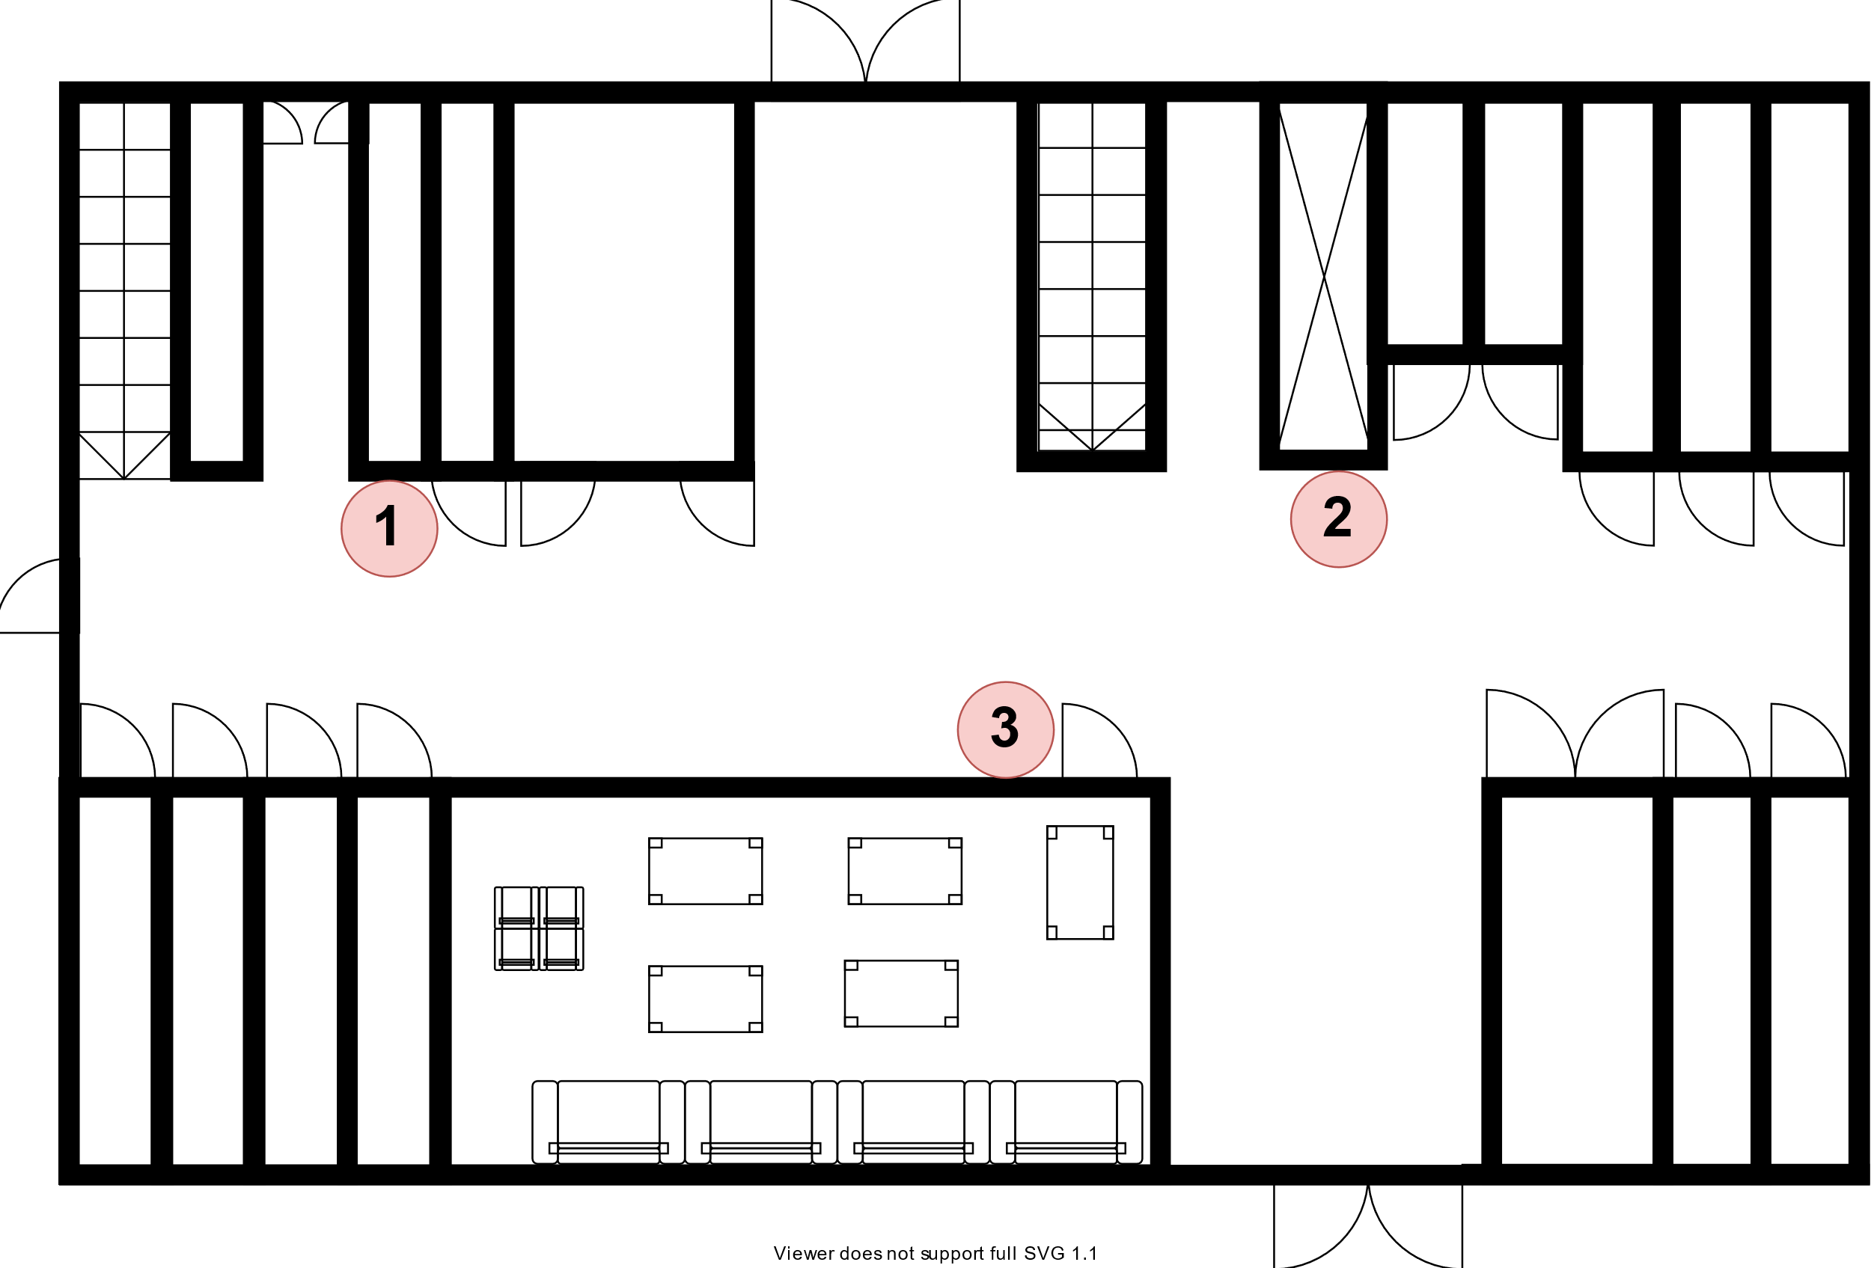

Design & Function
Process Diagram

Slide 24
Expectation Effectiveness

Slide 25
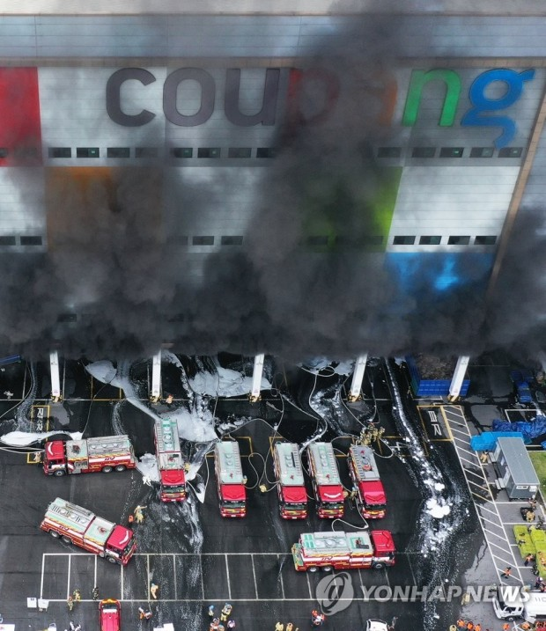
Expectation Effectiveness
Social Expected Effects
It helps reduce casualties in fire situations.
[ Coupang Fire Icheon Logistics Center Firefighter Rescue Team Found Dead ]

Slide 26




Expectation Effectiveness
Functional Expected Effects
2019 January National Police Agency Press Release
50 Meters Apart
We can keep the golden time to save people who need help.

Slide 27
Demonstrate Operation

Slide 28
Demonstrate Operation
시연영상

Slide 29
Demonstrate Operation
종합영상

Slide 30
Complementary Points

Slide 31
Complementary Points
1. HTML information is required to display pins on responsive web pages.
2. Because the CAT.m1 module is unstable, the communication module needs to be supplemented.

Slide 32
Question and Answer
Thank you for Listening
Please ask any Question

